Slide 1
Enhancing Security and Software Supply Chain: Recent and Upcoming Features in Harbor
Stone Zhang@Broadcom

Slide 2
Agenda
Harbor Community Update
Key Features in Recent Year
Next release
Roadmap
Demo
Q&A

Slide 3
V2.9.0 to 2.11 Key Features Recap
Security Hub
Robot Account Full Access
Distribution OCI Spec v1.1.0
SBOM Generation and Management
Enhanced Garbage Collection

Slide 4
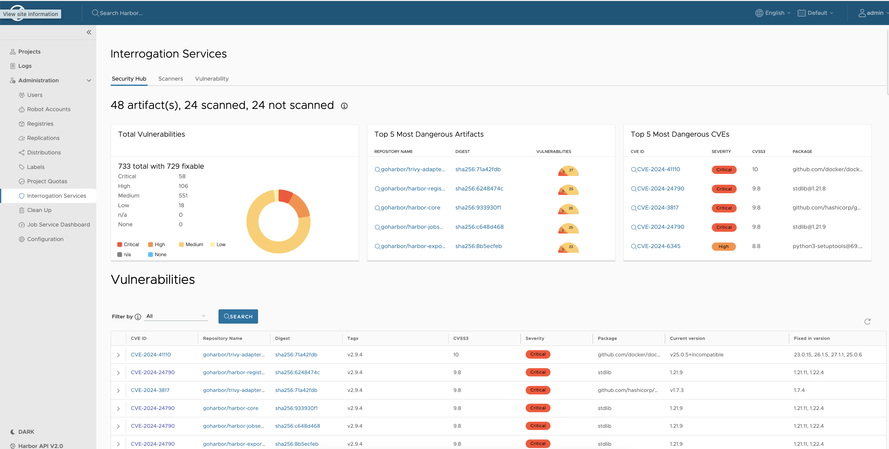
Security Hub
Provides security insight by project.
Search capability for vulnerabilities using multiple combined conditions

Slide 5
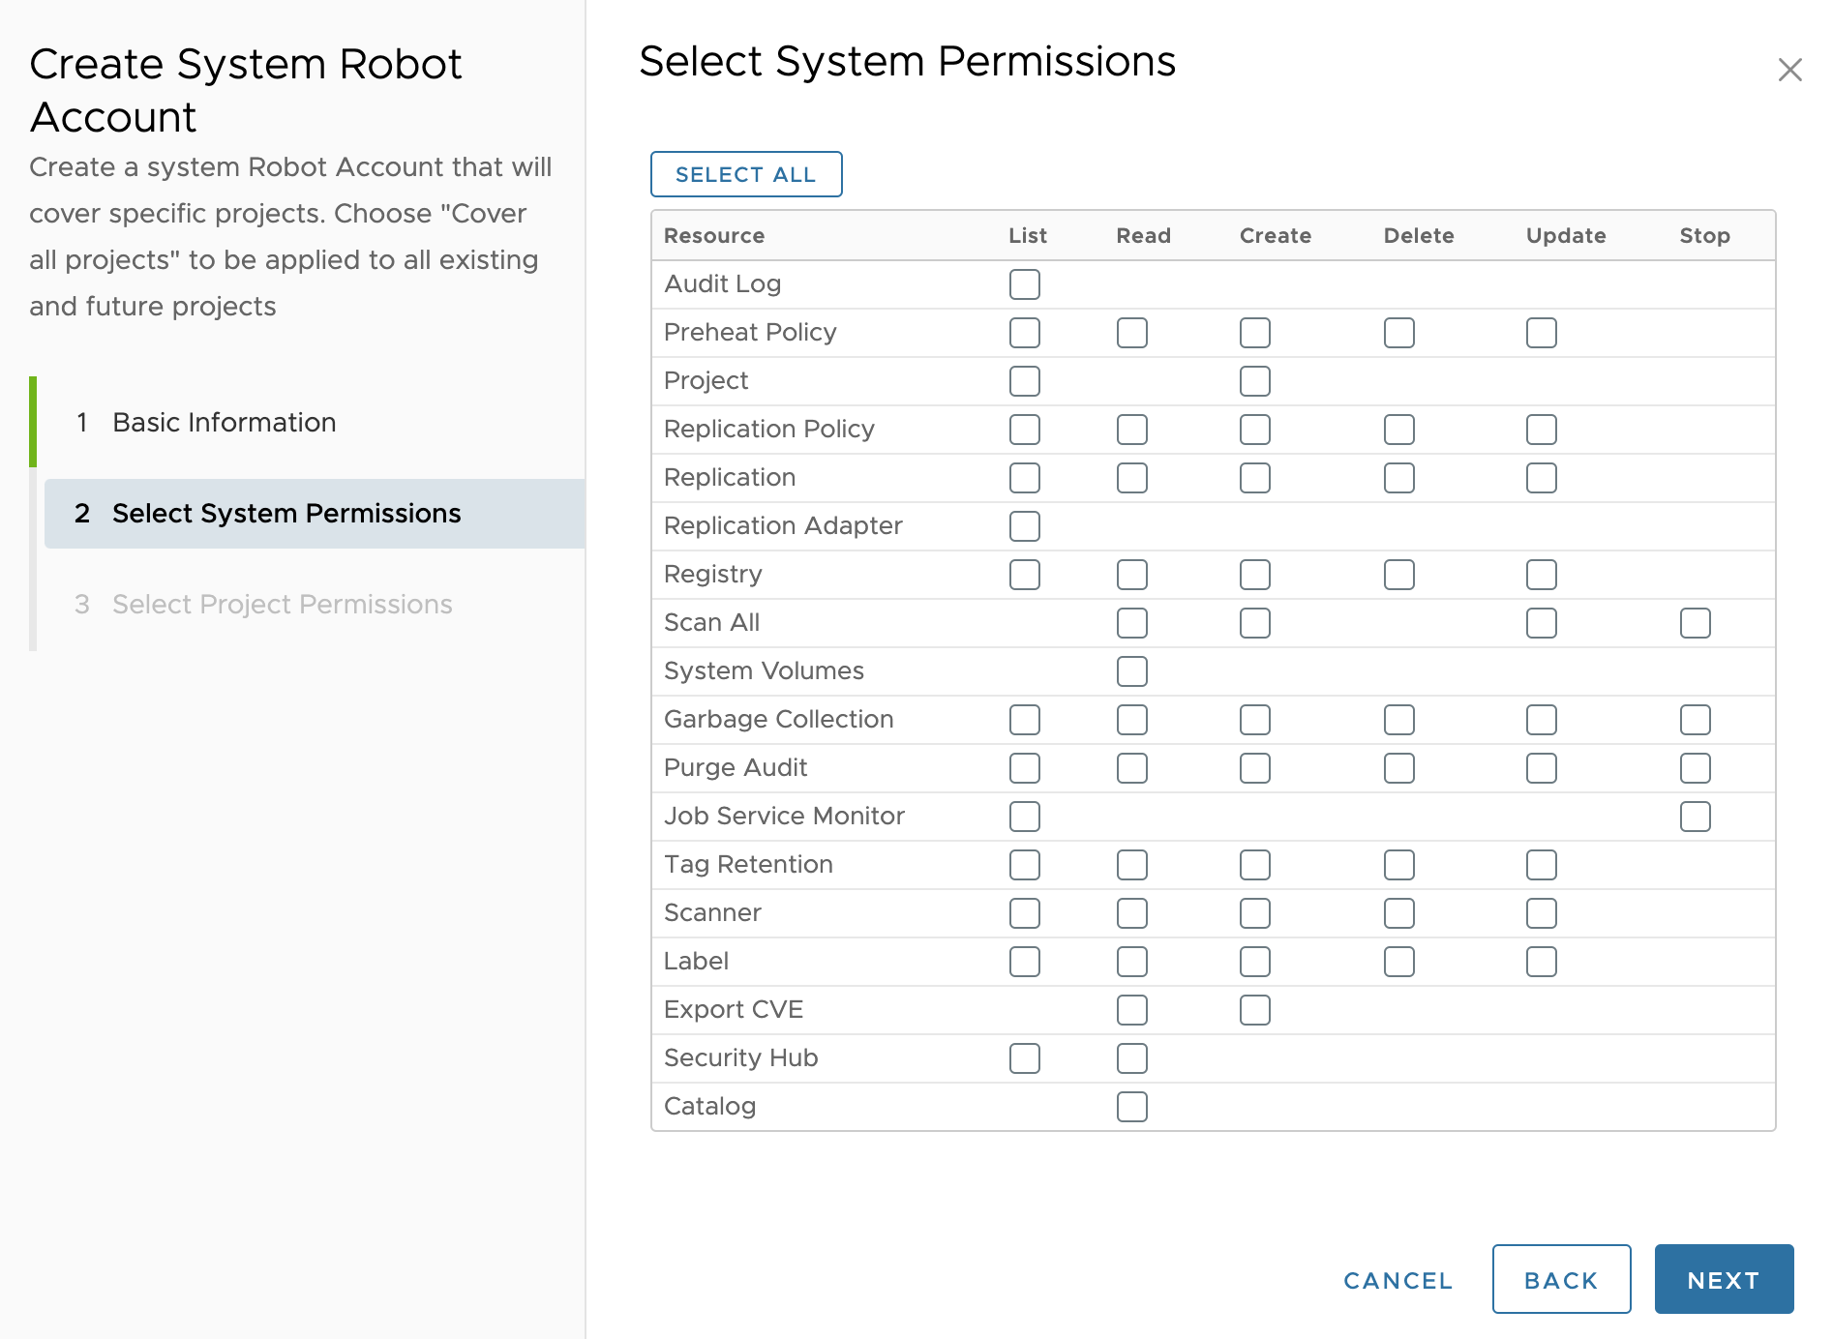
Robot Account Access
Provides step-by-step instructions for attaching a robot account to a set of APIs, ensuring clear and straightforward.
A user-friendly UI that displays the data dictionary, enabling users to make informed choices with ease.

Slide 6
Distribution Spec v1.1.0
Artifact Type: Creating and Storing Alternative Artifacts
This field's value is determined as follows:
a.) It corresponds to the artifactType provided on the manifest when it's pushed
b.) it matches the value of config.mediaType if the artifactType field is absent.
Introduction of a New Manifest Field to Establish Relationships
A novel field named "subject" can now be incorporated into manifests, including those in an index. This field points to another object within the registry.
New API Endpoint in the Registry for Querying Relationships
A new HTTP API endpoint has been introduced to facilitate querying relationships between objects within the registry: GET /v2/<name>/referrers/<digest>.

Slide 7
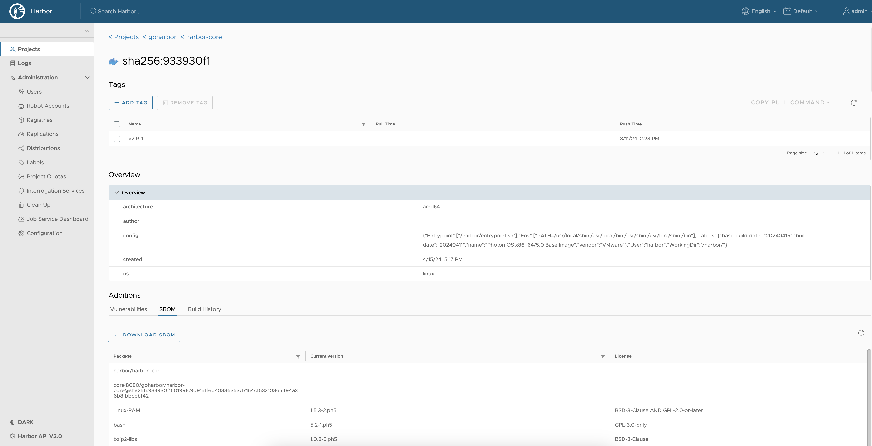
SBOM Generation and Management
Automatically generate SBOMs for OCI Artifacts.
Enable visual management and analysis of SBOMs, including features like export, download, and viewing.

Slide 8
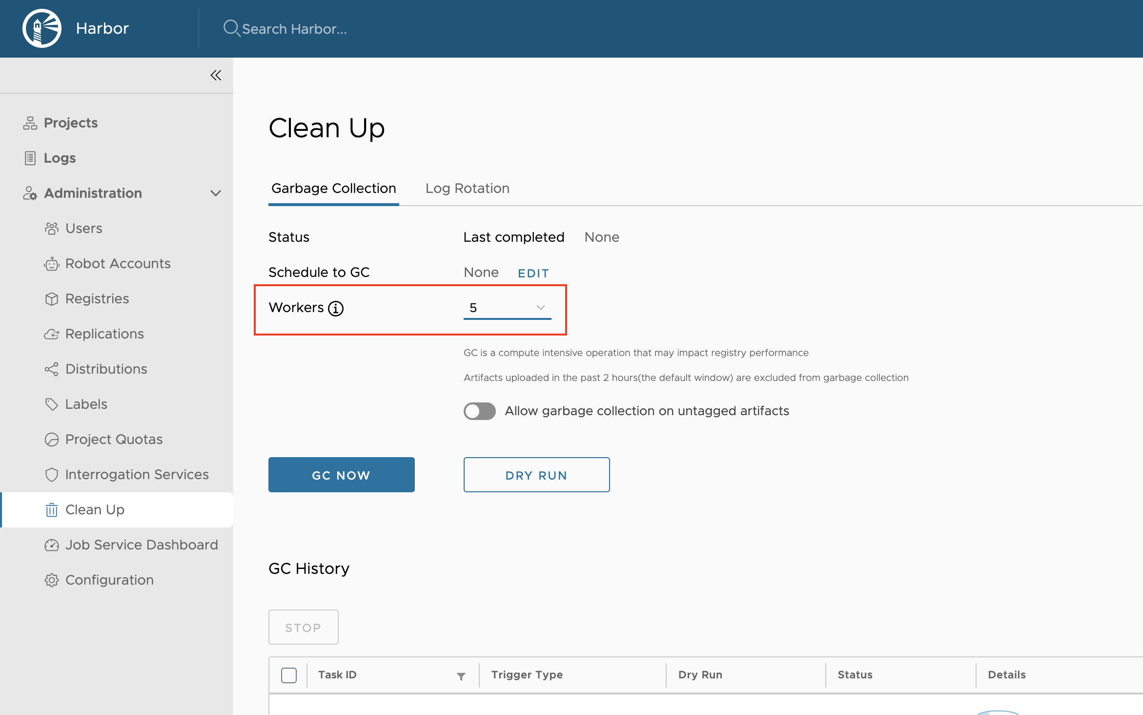
GARBAGE COLLECTION

Slide 9
Future
Rate Limiting Proxy Cache
Improve the Performance of LDAP Group
SBOM
Audit Log
Distribution V3
AI Model

Slide 10
Demo

Slide 11
Collabration
Slack
#harbor
#harbor-dev
Meeting
https://github.com/goharbor/community/wiki/Harbor-Community-Meetings
Demo
https://demo.goharbor.io

Slide 12
Q&A

